Slide 1


21AIE205
Python for Machine Learning

Slide 2


21AIE205
Python for Machine Learning

Slide 3
Team: 04
SECTION: E
TEAM MEMBERS:
M RAMYA SREE
(BL.EN.U4AIE21072)
METTU SIDDHARTHA (BL.EN.U4AIE21080)
POLI VAMSI VARDHAN REDDY
(BL.EN.U4AIE21101)
UNDER THE GUIDANCE OF:
MS. Niharika panda

Slide 4
FRAUD DETECTION IN BANKS
USING MACHINE LEARNING ALGORITHMS

Slide 5
Introduction
Problem statement
Description of each algorithm
Implementation
Result
References
CONTENTS

Slide 6


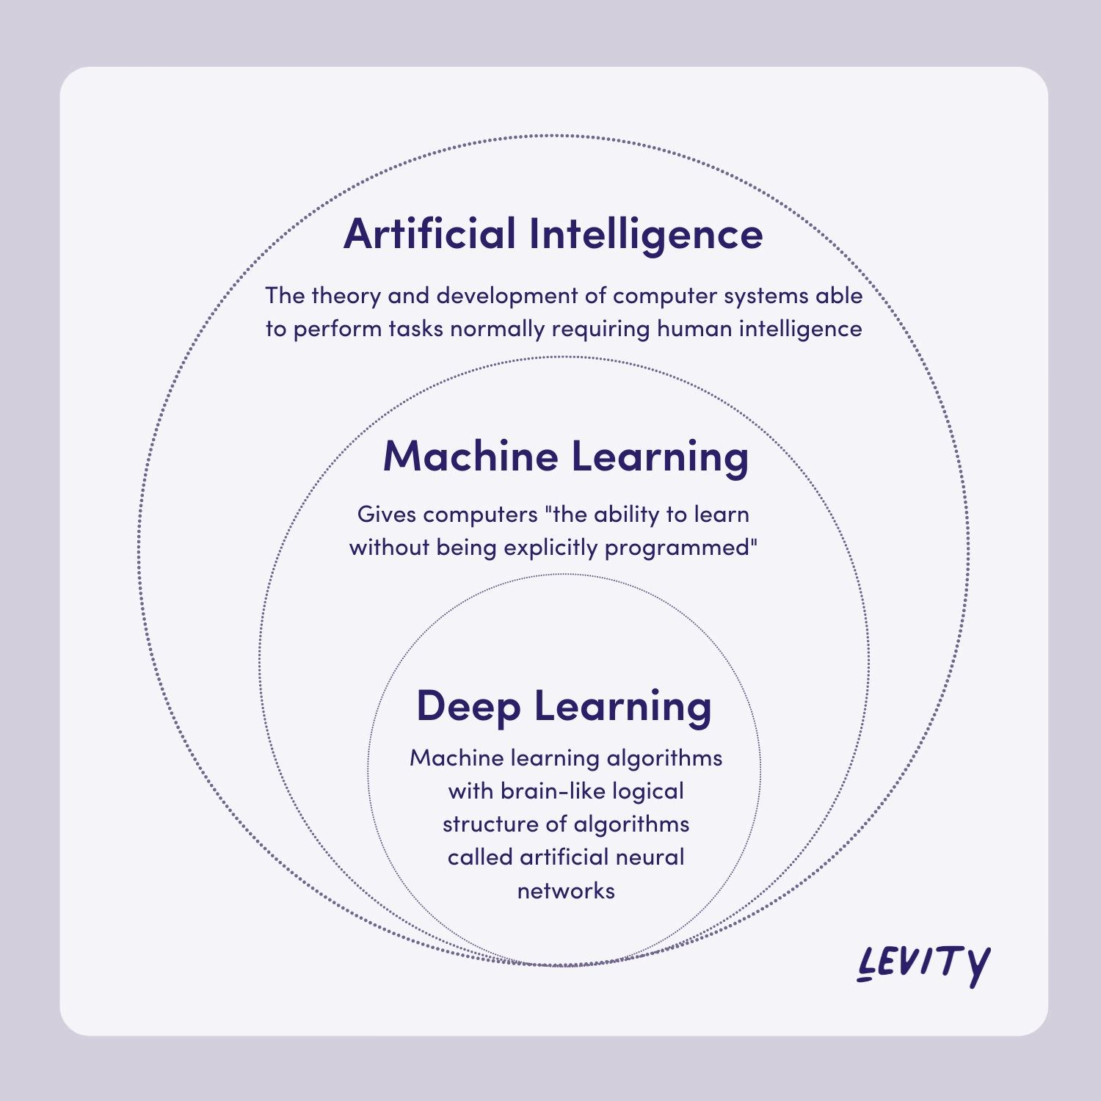
Artificial intelligence is the simulation of human intelligence processes by machines, especially computer systems. Specific applications of AI include expert systems, natural language processing, speech recognition and machine vision.
Machine learning is a subfield of artificial intelligence, which is broadly defined as the capability of a machine to imitate intelligent human behavior.
Deep learning is a subset of machine learning, which is essentially a neural network with three or more layers. These neural networks attempt to simulate the behavior of the human brain

Slide 7

Applications of Machine Learning
Traffic Alerts(Maps)
Fraud Detection
Google Translate
Autonomous Vehicles
Dynamic Pricing
Product Recommendation
Detection of Malware
Targeting Advertisements
Detecting SPAM

Slide 8
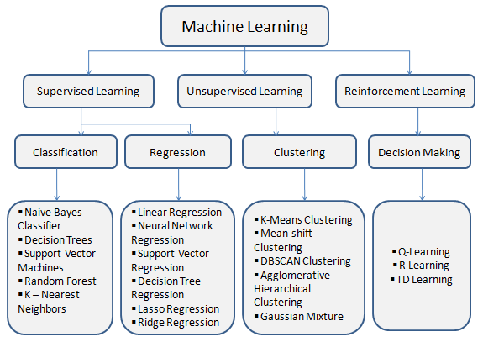

Slide 9
INTRODUCTION
Bank fraud is the use of illegal means to obtain money, assets, or other property from a financial institution.
It can take many forms, such as check fraud or credit card fraud.
Demonstrate how machine learning algorithms can be used to detect and prevent bank fraud.

Slide 10
PROBLEMS OF BANK FRAUD
Bank fraud is a significant problem for both banks and their customers.
It damages the reputation of the banks.
It causes financial hardship and stress for customers who are victims of fraud.
Bank fraud can be difficult to detect and prevent, as perpetrators often use sophisticated methods to conceal their activities.

Slide 11
Solutions for bank frauds
Effective fraud detection methods are needed for protecting banks and their customers against fraudulent activity.
Traditional fraud detection methods, such as manual review of transactions, can be time-consuming and may not be able to detect fraudulent activities.
The use of machine learning algorithms is one way that banks can try to improve their ability to detect and prevent bank fraud.

Slide 12
WHY Machine Learning Algorithms?
Machine learning algorithms can analyze large amounts of data quickly and accurately.
Machine learning algorithms can adapt and improve over time, as they learn from new data and experiences.
Machine learning algorithms can operate automatically, without the need for manual intervention.
Machine learning algorithms can be more objective and unbiased than human reviewers.
The use of machine learning algorithms can increase the effectiveness and efficiency of fraud detection in the banking industry.

Slide 13
About problem
KNN
SVM
DECISION TREE
RANDOM FOREST
LOGISTIC REGRESSION

Slide 14
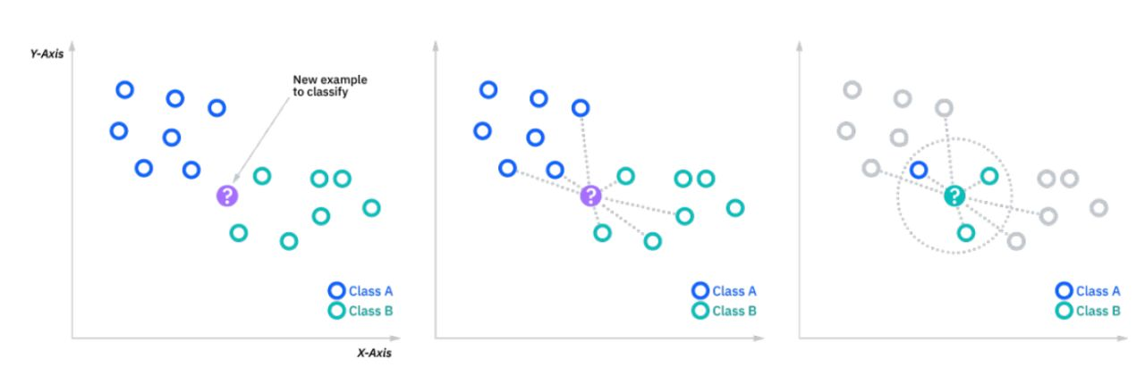
k-nearest neighbors algorithm
The k-nearest neighbors algorithm is a non-parametric, supervised learning classifier, which uses proximity to make classifications or predictions about the grouping of an individual data point.

Slide 15
Working
To classify a new transaction as fraudulent or legitimate, the KNN algorithm compares the new transaction to a set of pre-labeled transactions.
The algorithm looks at the k transactions in the dataset that are most similar to the new transaction, based on some distance measure, and classifies the new transaction based on the majority class of those k nearest neighbors.
One advantage of KNN is that it is simple and easy to implement.
But it can also be computationally expensive and may not perform as well as more complex algorithms on large datasets.

Slide 16
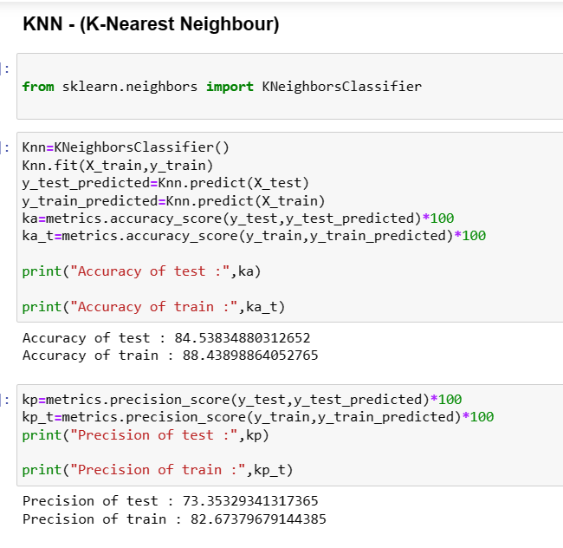
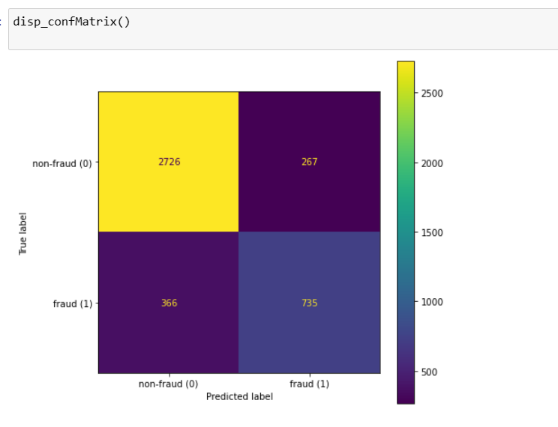
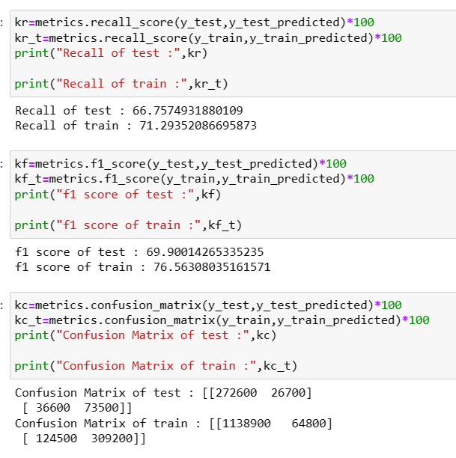

Slide 17
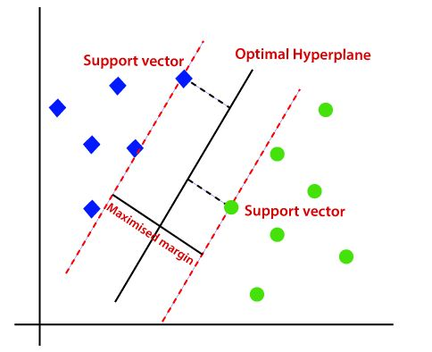
Support Vector Machines (SVM)
Support Vector Machines (SVMs) are a type of supervised learning algorithm that works by finding the hyperplane in a high-dimensional feature space that maximally separates the different classes.

Slide 18
Working
One way to use SVMs for fraud detection is to create a model that takes a set of transactions as input and predicts whether or not each transaction is fraudulent.
To do this, the model would be trained on a dataset of known fraudulent and non-fraudulent transactions.
The model would then be able to classify new transactions as either fraudulent or non-fraudulent based on how similar they are to the transactions in the training dataset.

Slide 19
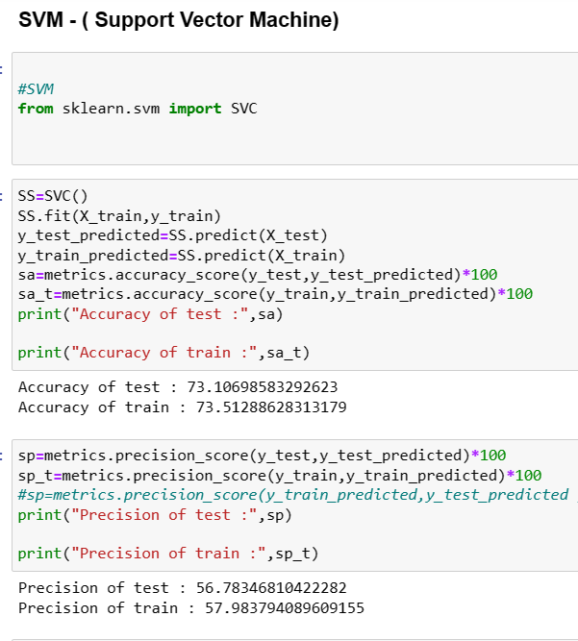
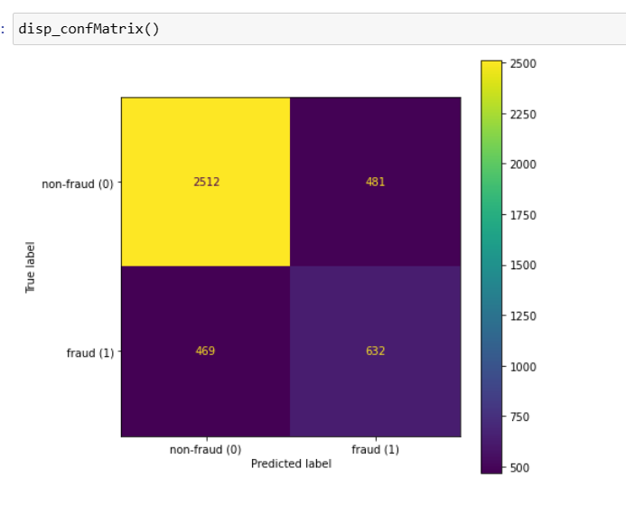
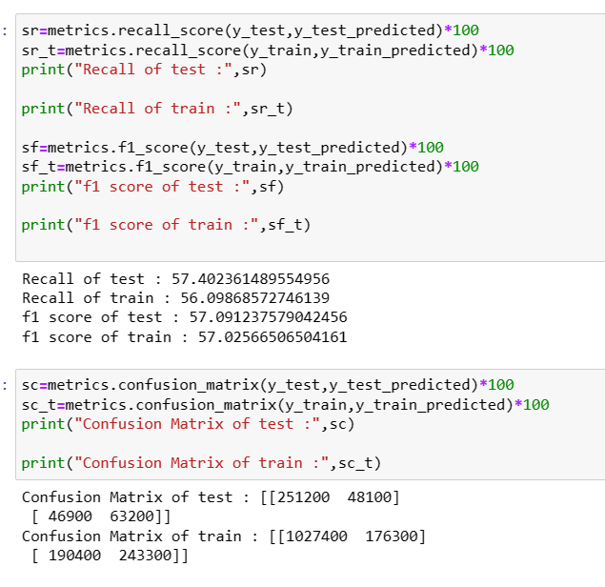

Slide 20
Applications of SVM
Text classification: SVMs have been used to classify text documents into predefined categories, such as spam emails and legitimate emails.
Handwriting recognition: SVMs have been used to recognize handwritten characters and digits, making it possible to digitize handwritten documents and handwritten notes.
Bioinformatics: SVMs have been used to classify proteins and predict the presence of certain diseases based on gene expression data.
Image classification: SVMs have been used to classify images into different categories, such as photographs of animals, people, or landscapes.
Fraud detection: SVMs have been used to detect fraudulent transactions in the financial industry, due to their high accuracy and ability to achieve a low false positive rate.

Slide 21
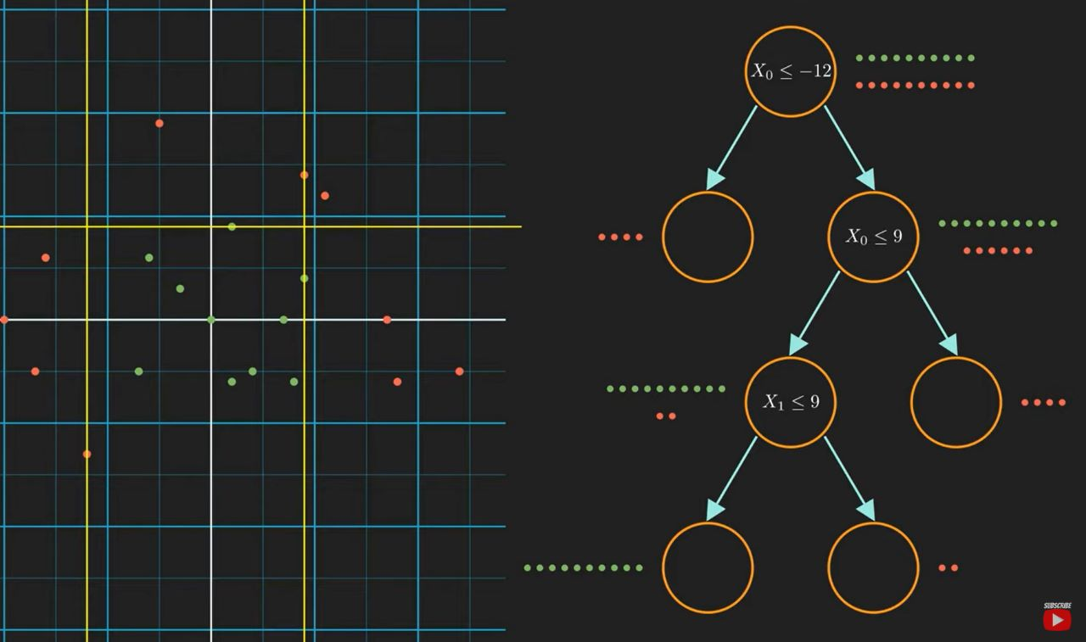
Decision Tree
A decision tree is a non-parametric supervised learning algorithm, which is utilized for both classification and regression tasks.
It has a hierarchical, tree structure, which consists of a root node, branches, internal nodes, and leaf nodes.

Slide 22
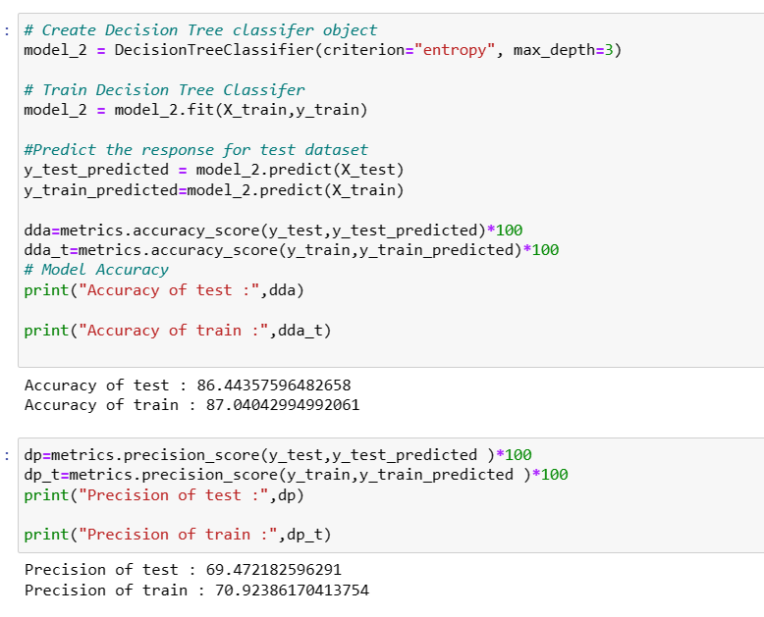
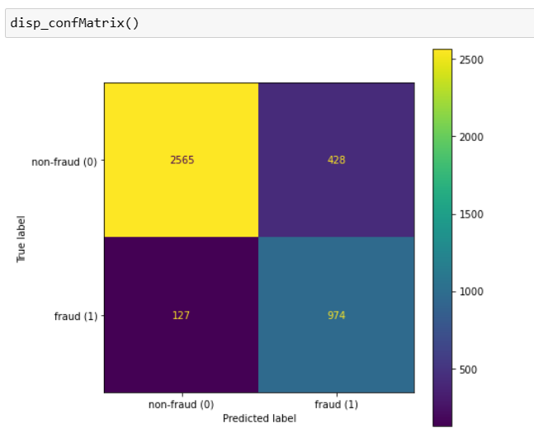
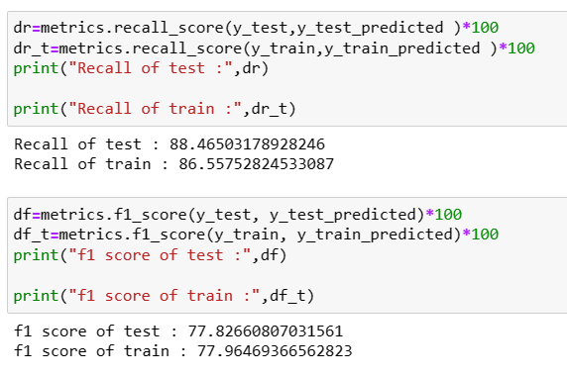

Slide 23
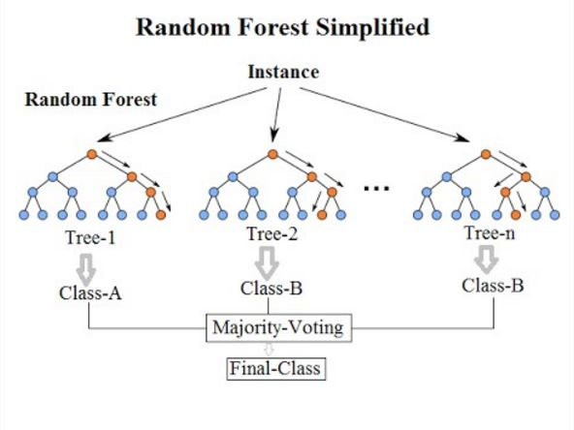
Random Forest
Random forests are a type of ensemble learning method for classification and regression.
They are composed of a collection of decision trees, where each tree is trained on a randomly selected subset of the data.
The predictions made by each tree are then combined to produce the final prediction made by the random forest.

Slide 24
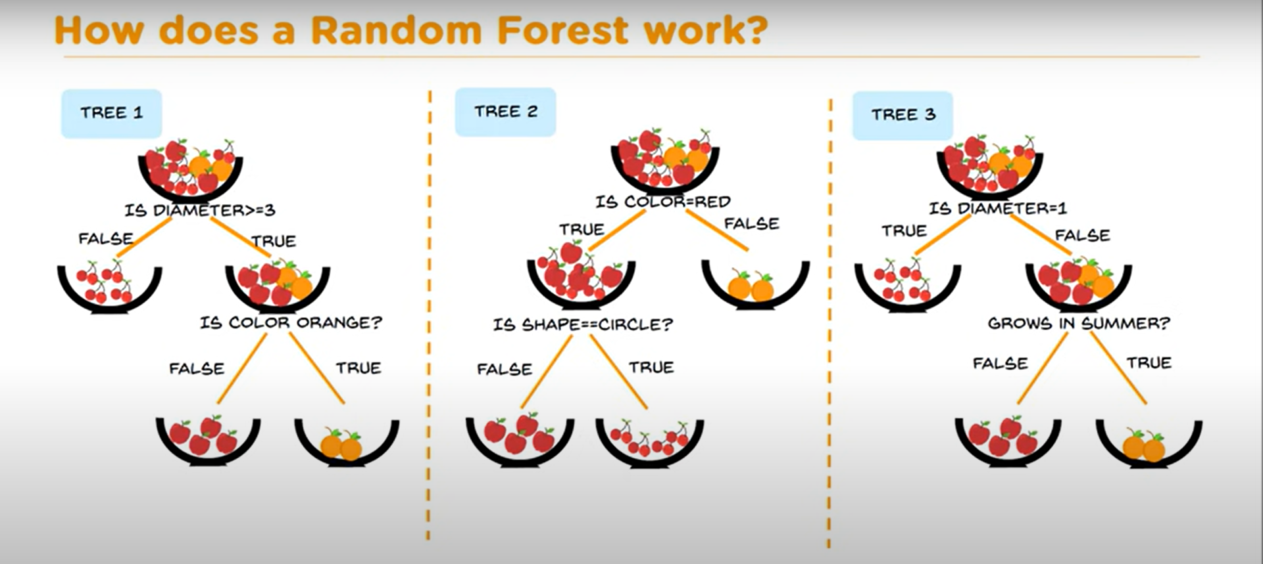
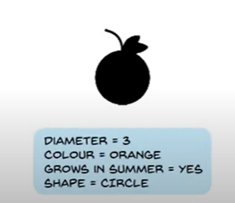


Slide 25
Working
In the context of analyzing bank frauds, a random forest algorithm could be used to identify patterns or trends in fraudulent activity that are not readily apparent from individual decision trees.
By combining the predictions of multiple decision trees, a random forest algorithm can provide a more robust and accurate model for detecting and preventing fraud.

Slide 26
Why Random Forest Algorithm
Random forests are effective at identifying complex patterns in data, making them well-suited for identifying unusual patterns in bank transactions.
Random forests are fast and efficient, making them well-suited for real-time fraud detection.
Random forests can handle large and complex datasets, making them a good choice for analysing a large number of bank transactions.

Slide 27
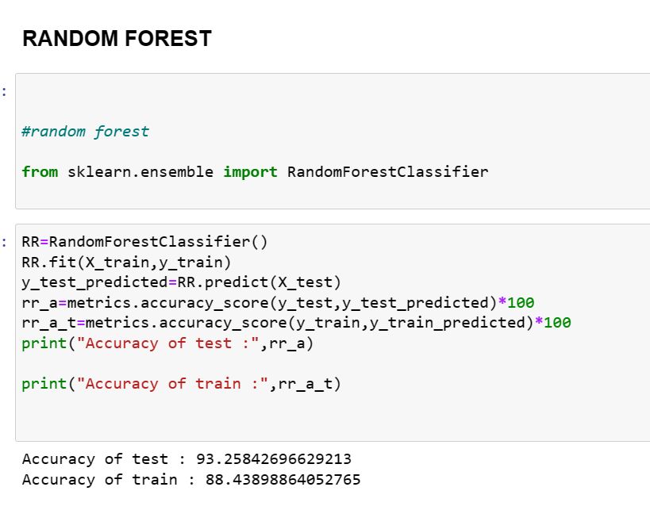
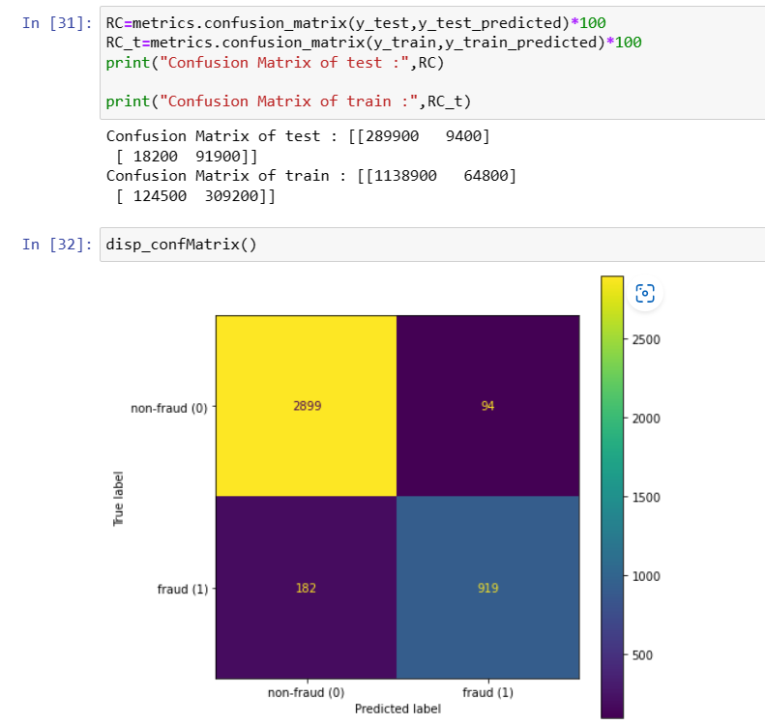
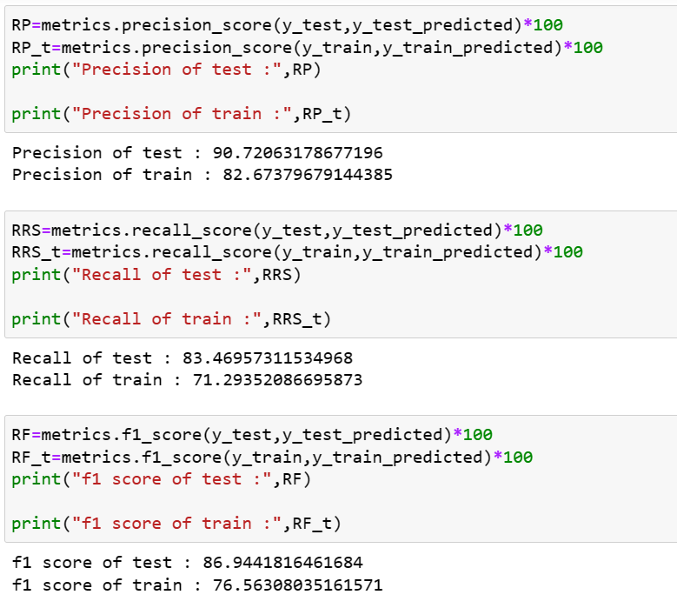

Slide 28
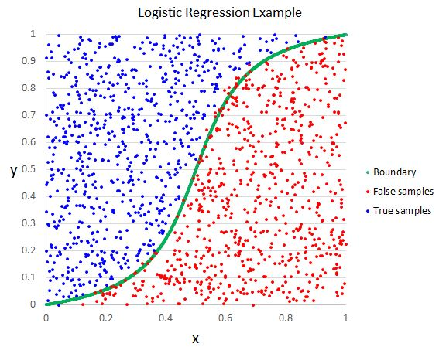
Logistic Regression
Logistic regression is a type of statistical analysis used for predicting binary outcomes.
The dependent variable is a binary variable that contains data coded as 1 (yes, success, etc.) or 0 (no, failure, etc.), and also it’s discrete.
The goal is to find the best coefficients (w) for the features (X) that minimize the error in the predictions.

Slide 29

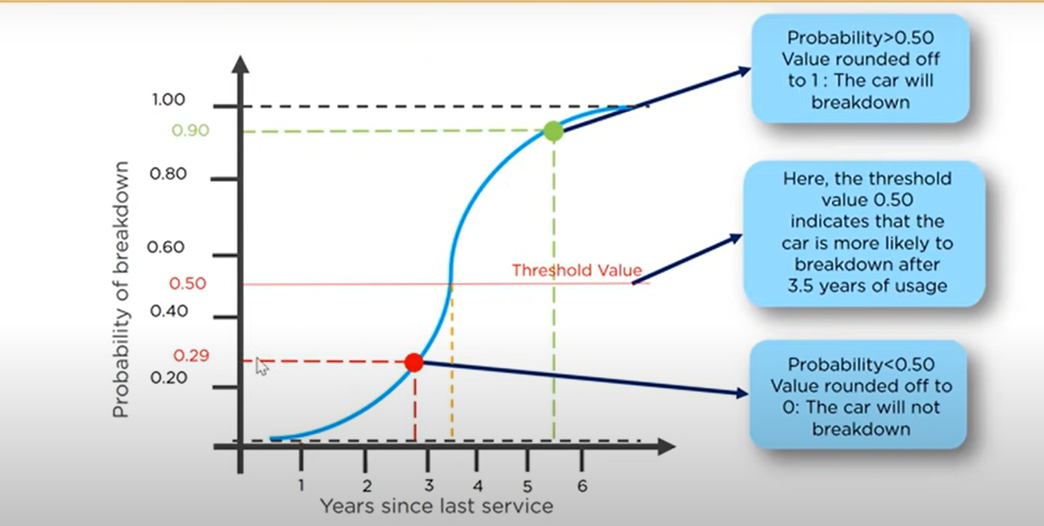
Let’s say your car has not been serviced for a few years…
You need to find out whether it breaks down in the future

Slide 30
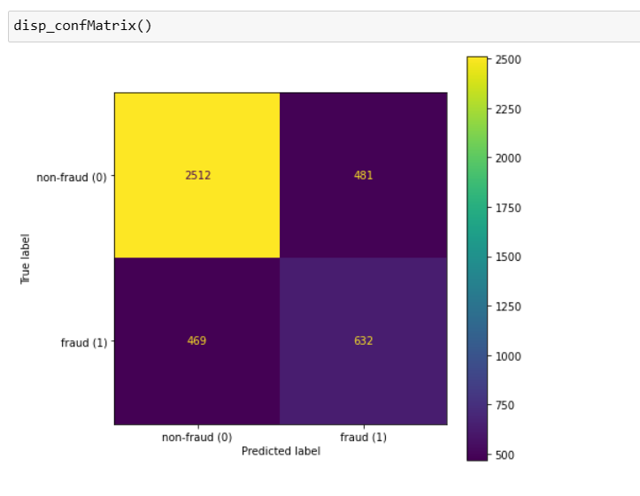
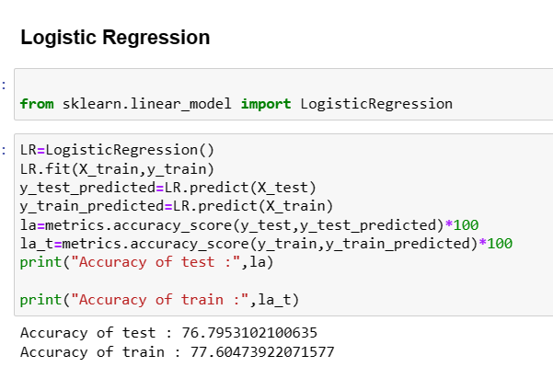
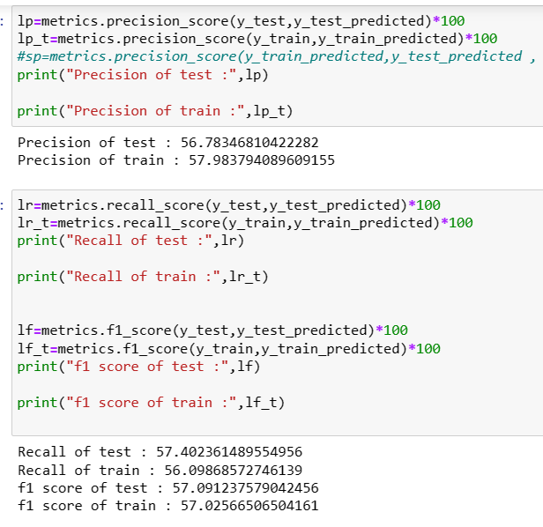
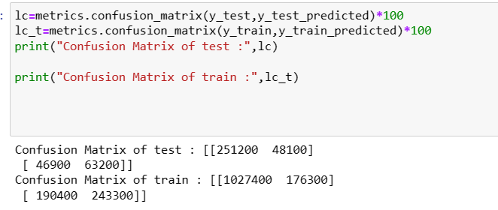

Slide 31
IMPLEMENTATION

Slide 32
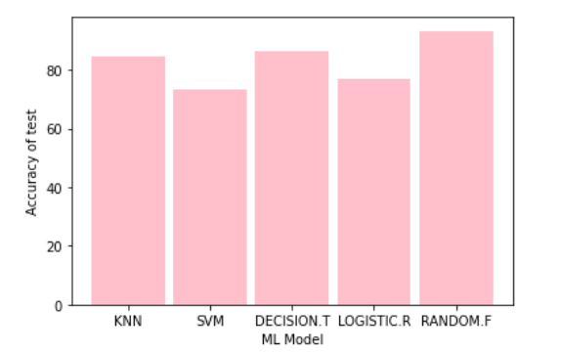
GRAPHS

Slide 33
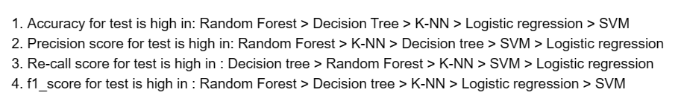
CONCLUSION
The analysis of fraud detection using KNN, SVM, decision trees, and random forests showed that all four methods can be effective in detecting fraud.

Slide 34
REFERENCE
[1] Alkhatib, K. I.-A. (2021). Credit Card Fraud Detection Based on Deep Neural Network Approach. 12th International Conference on Information and Communication Systems (ICICS) (pp. 153-156). IEEE. DOI: https://doi.org/10.1109/ICICS52457.2021.9464555
[2] Faraji, Z. (2022). A Review of Machine Learning Applications for Credit Card Fraud Detection with A Case study. SEISENSE Journal of Management, 5(1), 49–59.
[3] https://www.kaggle.com/
[4] Alkhatib, K. I.-A. (2021). Credit Card Fraud Detection Based on DeepNeural Network Approach. 12th International Conference on Informationand Communication Systems (ICICS) (pp. 153-156). IEEE. DOI
[5] "A Comparative Study of Machine Learning Algorithms for Fraud Detection in the Banking Industry" by Hossain et al. (2020) compares the performance of KNN, SVM, and several other machine learning algorithms on a dataset of bank transactions. The authors found that SVM outperformed KNN in terms of accuracy, but KNN was faster to train.

Slide 35
Thank you

